Slide 1

Major Project Presentation
Voice Based Banking for Rural Areas
Team Members
Sushrutha Shanbhogue 4SF22CS225
Raghavendra SS 4SF22CS158
Sowndarya S 4SF22CS218
Iram A.K Shaikh 4SF23CS404
Under the Guidance of:
Mr. Raghavendra Sooda Assistant Professor,
Dept of CSE, SCEM
Department of Computer Science and Engineering

Slide 2
Domain of the project
Technical Domain: This project belongs to the field of Artificial Intelligence, focusing on speech recognition and natural language processing. It uses OpenAI’s Whisper model to convert Kannada speech into English text. The system includes a chatbot that understands user intent and performs the provided tasks. Tasks such as it automates document generation and provides voice feedback in English.
Business Domain: The project falls under the banking and financial services domain, targeting rural populations. It aims to promote financial inclusion by making banking services accessible through voice. It helps bring banking to underserved communities using local language support.
Department of CSE

Slide 3
Abstract
Access to banking services remains a major challenge for rural populations in India due to language barriers, low digital literacy, and limited familiarity with formal financial systems. This project, titled “Voice-Based Banking for Rural Areas,” addresses these issues by developing a smart, voice-enabled chatbot that allows users to interact with banking services in their native language—Kannada. The system uses OpenAI’s Whisper model, multilingual speech recognition and translation tool, to transcribe and translate user voice input from Kannada to English text. It enables users to perform key tasks such as opening a bank account and filling out loan applications. To improve usability and ensure accurate documentation, the system also automatically generates or fills in banking-related documents, such as application forms or newly creation of the bank account. The chatbot responds with the audio feedback in Kannada and provides the text-based output in an English, providing a clear and user-friendly experience.

Slide 4
Contents
Introduction
Problem Statement
Objectives
Literature Survey
Project Design
System Requirements Specification
Gantt Chart
Conclusion
References
Department of CSE

Slide 5
Introduction
In India, digital banking is growing rapidly, but many people in rural areas still struggle to access these services due to low literacy, limited digital skills, and language barriers. Most banking systems are in English and text-based, which makes them hard to use for many rural users. To solve this, we propose a voice-based banking chatbot that lets users interact in their regional language, like Kannada.
Using OpenAI’s Whisper model, the system converts spoken language into English text, understands the user's request, and performs basic banking tasks. It enables users to perform key tasks such as opening a bank account and filling out loan applications. This solution aims to make banking more accessible, build trust in digital tools, and empower rural communities to manage their finances independently.
Department of CSE

Slide 6
Problem Statement
Many people from rural area faces difficulties in filling the form while creating a new bank account and filling the loan application form due to language barriers, low digital literacy, and unfamiliarity with formal financial systems. Existing banking platforms often rely on English and text-based interfaces, which are not user-friendly for rural populations. There is a need for an accessible solution that allows users to interact with banking services in their native language using simple, voice-based communication.
Department of CSE

Slide 7
Objectives
To design a user-friendly interface that accommodates users with low or no digital literacy, minimizing the need for typing, reading, or understanding English
To develop a voice-based chatbot system that allows rural users to interact with banking services using natural speech in Kannada
To integrate OpenAI’s Whisper model for accurate speech recognition and real-time translation of spoken Kannada into English for further processing
Department of CSE

Slide 8
LITERATURE SURVEY
Sl. No. | Paper Title & Year of Publication | Author/s | Key Findings | Methodologies used
1 | Robust Speech Recognition via Large-Scale Weak Supervision, 2022 | Alec Radford, Jong Wook Kim, Tao Xu, Greg Brockman, Christine McLeavey, Ilya Sutskever | Whisper delivers strong zero-shot performance, in robustness and long-form transcription. Scaling data and model size boosts multilingual accuracy, approaching human-level results. | Whisper is a Transformer-based speech model trained on 680k hours of multilingual, multitask audio-text data, using a unified token-based format and minimal preprocessing for tasks like transcription and translation.
2 | UniSpeech-SAT: Universal Speech Representation Learning with Speaker-Aware Pre-training, 2022 | Chen et al. | Improved speaker recognition and personalization in speech systems; useful for authentication in banking.. | Speaker-aware pre-training; Fine-tuning for ASR and speaker verification; Selfsupervised representation learning.
Department of CSE

Slide 9
3 | Maestro: Matched Speech Text Representations Through Modality Matching, 2022 | Chen et al. | Combines speech and text learning to enhance ASR performance; supports seamless speech-to-text conversion in banking | Joint training on aligned speech-text pairs; Modalitymatching architecture; Finetuning for downstream tasks.
4 | Unsupervised Speech Recognition, 2021 | Baevski et al. | Eliminated need for labeled audio data; supports voice apps in rural settings lacking transcription data. | Pretraining with wav2vec 2.0; Fine-tuning with small transcribed sets; Unsupervised decoding.
5 | SpeechStew: Simply Mix All Available Speech Recognition Data to Train One Large Neural Network, 2021 | Chan et al. | Demonstrated large-scale data aggregation improves ASR across domains; applicable for mixed-accent rural voices. | Dataset mixing; Transformer-based ASR model; Joint training on multiple corpora; Robust to noise and accent variance.
Department of CSE

Slide 10
6 | VoxPopuli: A large-scale multilingual speech corpus for representation learning, semi supervised learning and interpretation, 2021 | Wang, C. et al. | Introduced a large multilingual dataset (~400K hours, 23 languages) ideal for training robust voice systems in low-resource and rural language settings. | Self-supervised learning (SSL); Data collection from EU Parliament; Pretraining for ASR and multilingual tasks.
7 | XLS-R: Self Supervised Cross-Lingual Speech Representation Learning at Scale, 2021 | Babu et al. | Enabled multilingual speech recognition, useful for diverse rural languages; improved low-resource language support. | Cross-lingual self-supervised learning; pre-trained on 436 languages; Fine-tuning for specific domains.
8 | Self-training and Pre-training are Complementary for Speech Recognition, 2021 | Xu, Q. et al. | Demonstrated that combining SSL pretraining and pseudo-label self training significantly improves performance, especially for low-resource domains. | wav2vec 2.0 + pseudo labelling; Semi-supervised pipeline; ICASSP evaluation on Libri Speech and Common Voice.
Department of CSE

Slide 11
9 | Multitask Training with Text Data for End-to-End Speech Recognition, 2020 | Wang, P. et al. | Showed that incorporating text-only data improves ASR performance, enabling better generalization where speech data is scarce. | Multitask training; CTC/attention-based hybrid models; Text-based language modeling integration.
10 | Attention Is All You Need, 2017 | Ashish Vaswani, Noam Shazeer, Niki Parmar, Jakob Uszkoreit, Llion Jones, Aidan N. Gomez, Łukasz Kaiser, Illia Polosukhin | The Transformer achieves state-of-the-art translation with reduced training time, generalizes to other tasks, and scales efficiently thanks to parallelism and shorter path lengths. | The paper proposes the Transformer model, which uses only self-attention mechanisms for efficient and parallel sequence transduction.
Department of CSE

Slide 12
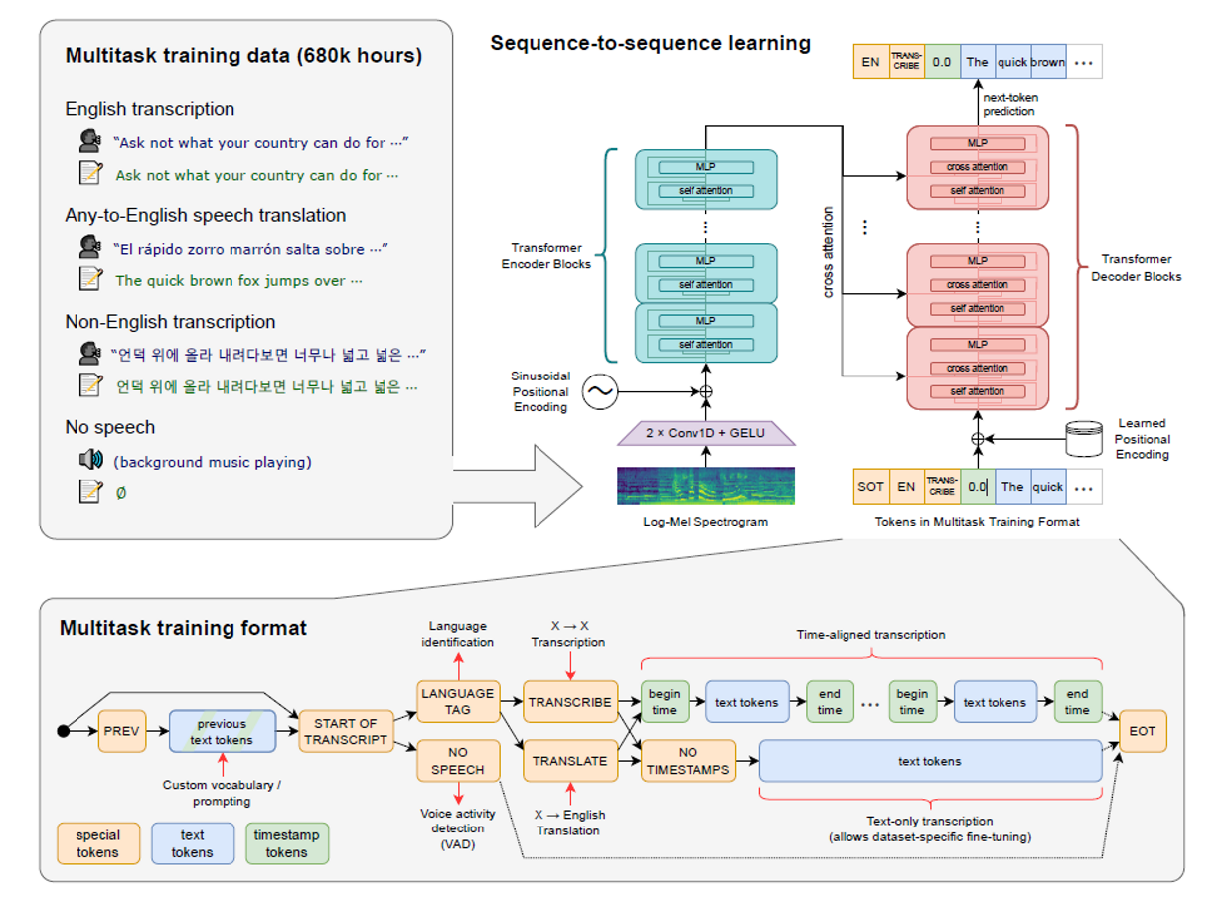
Project Design
Figure 2: sequence -to-sequence Transformer model architecture
Department of CSE

Slide 13
Project Design
Components of the sequence – to – sequence Transformer model architecture:
1. Log-Mel Spectrogram
A Log-Mel Spectrogram converts audio signals into a time-frequency representation using the Mel scale and logarithmic amplitude.
In sequence-to-sequence Transformers, it serves as the input feature for the encoder.
2. 2 x Conv1D + GELU
The 2 x Conv1D + GELU block applies two 1D convolution layers with GELU activation in between.
It captures local temporal patterns and non-linear features from the input sequence, such as audio or embeddings. .
3. Sinusoidal Positioning
Sinusoidal Positioning encodes token positions using sine and cosine functions of different frequencies.
It provides fixed positional information to input embeddings, enabling the model to understand token order.
4. Self – Attention
Self-Attention allows each token in a sequence to weigh and attend to other tokens using query, key, and value projections.
It helps the model capture contextual relationships regardless of token position.
5. Multi – Layer Perceptron
The applies two linear layers with a non-linear activation in between.
It processes each token's representation independently to enhance feature transformation.
Department of CSE

Slide 14
Project Design
6. Cross – Attention
Cross-Attention allows the decoder to attend to encoder outputs using queries from the decoder and values from the encoder.
It helps the model align and extract relevant information from the input sequence.
This mechanism is essential for generating context-aware outputs in sequence-to-sequence tasks.
7. Learned – Positional Encoding
Learned Positional Encoding uses trainable embeddings to represent token positions in a sequence.
These embeddings are added to input embeddings to provide the model with positional context.
Unlike fixed sinusoidal encoding, they are optimized during training for the specific task.
Step 4: Translated Voice Reply
The English translation is converted into speech using a Transformer based Text-to-Speech (TTS) engine
The system speaks out the English reply to confirm understanding
Step 5: Document Generation
If the query involves a task like depositing or withdrawing money:
The system extracts relevant info (name, amount, account number, etc.).
Fills a bank form template (e.g., withdrawal slip, application form).
Department of CSE

Slide 15
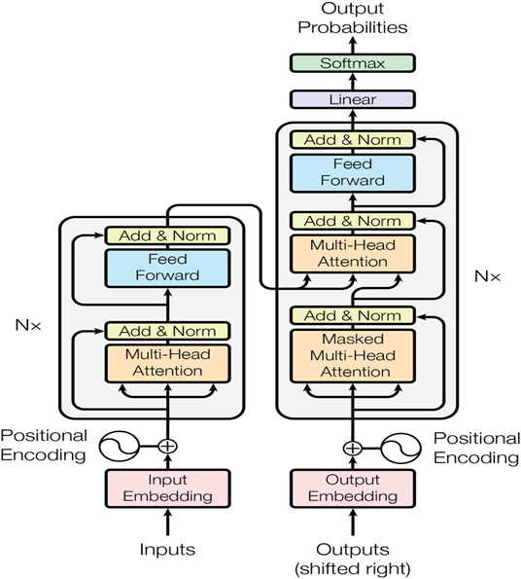
Project Design
Figure 1: Transformer model architecture
Department of CSE

Slide 16
Project Design
Components of the Transformer model architecture:
1. Input Embedding
Input Embedding maps each token ID to a dense vector using a learnable embedding matrix.
It captures semantic meaning and converts discrete tokens into continuous representations.
2. Positional Encoding
Positional Encoding adds information about token positions to the input embeddings.
Since Transformers lack recurrence, this helps the model understand the order of tokens.
3. Multi-Head Attention
Positional Encoding adds information about token positions to the input embeddings.
Since Transformers lack recurrence, this helps the model understand the order of tokens.
4. Add & Norm
Add & Norm applies residual connections by adding the input to the output of a sub-layer such as feed forward.
This helps preserve input information and improves gradient flow during training
5. Feed Forward
The Feed Forward layer applies two linear transformations with a ReLU activation in between.
It processes each position independently to add non-linearity and enhance feature representation.
Department of CSE

Slide 17
Project Design
6. Output Embedding
• Output Embedding maps the decoder’s output vectors to vocabulary logits using a linear layer.
• It converts high-dimensional features into a probability distribution over the target vocabulary.
• This allows the model to predict the next token during sequence generation.
7. Linear Layer
• The Linear layer applies a learned weight matrix to transform input vectors into a new feature space.
• It is used to project outputs, such as attention results or hidden states, into desired dimensions.
• This transformation is essential for tasks like generating logits over the vocabulary.
8. SoftMax Layer
• The SoftMax function converts raw logits into a probability distribution over the target classes.
• In Transformers, it is used in the attention mechanism and final output layer.
• It ensures the model assigns probabilities that sum to 1, enabling token prediction or attention weighting.
Department of CSE

Slide 18
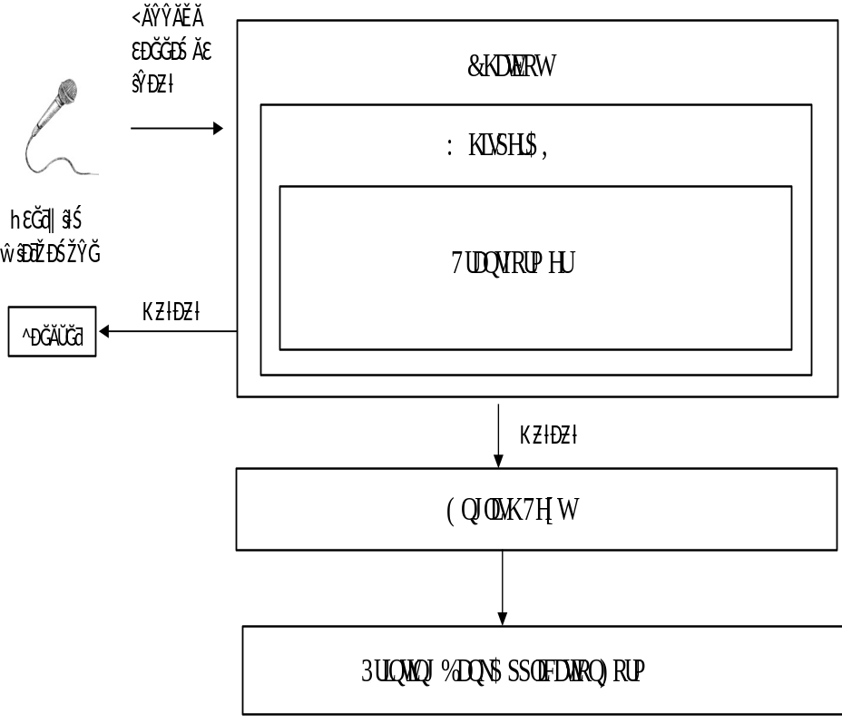
Project Design
Input (Microphone):
A user speaks into a microphone, providing voice input (e.g., "I want to open a bank account").
Whisper AI (Transformer Model):
The speech signal is processed using Whisper AI, which uses a Transformer architecture to:
Transcribe spoken language to text.
Understand language context.
Convert it into actionable information.
Text Output:
The transcribed text is interpreted as a command or intent (e.g., filling out a bank application).
Action (Print Form):
Based on the interpreted command, the system triggers “Printing Bank Application Form”.
Architectural Diagram
Department of CSE

Slide 19
System Requirements Specification
FUNCTIONAL
REQUIREMENTS
Accept Kannada voice input.Transcribe speech using OpenAI Whisper.Translate to English using Transformer model.Process queries via chatbot.Generate filled banking documents.Respond in Kannada via TTS.Simple web/mobile interface.
NON-FUNCTIONAL
REQUIREMENTS
Easy to use, even for non-literate users.Fast response (within 3–5 seconds).Noise-tolerant and secure.Scalable for more languages/features.
HARDWARE
REQUIREMENTS
Client: Android phone/PC with mic/speaker, 2 GB RAM.Server: 8-core CPU, 16+ GB RAM, GPU, Ubuntu OS.
SOFTWARE
REQUIREMENTS
Python 3.8+, Whisper, Transformers, Flask/Django, PyTorch/TensorFlow, TTS, FPDF/python-docx.Chrome/Firefox browser for frontend.
Department of CSE

Slide 20
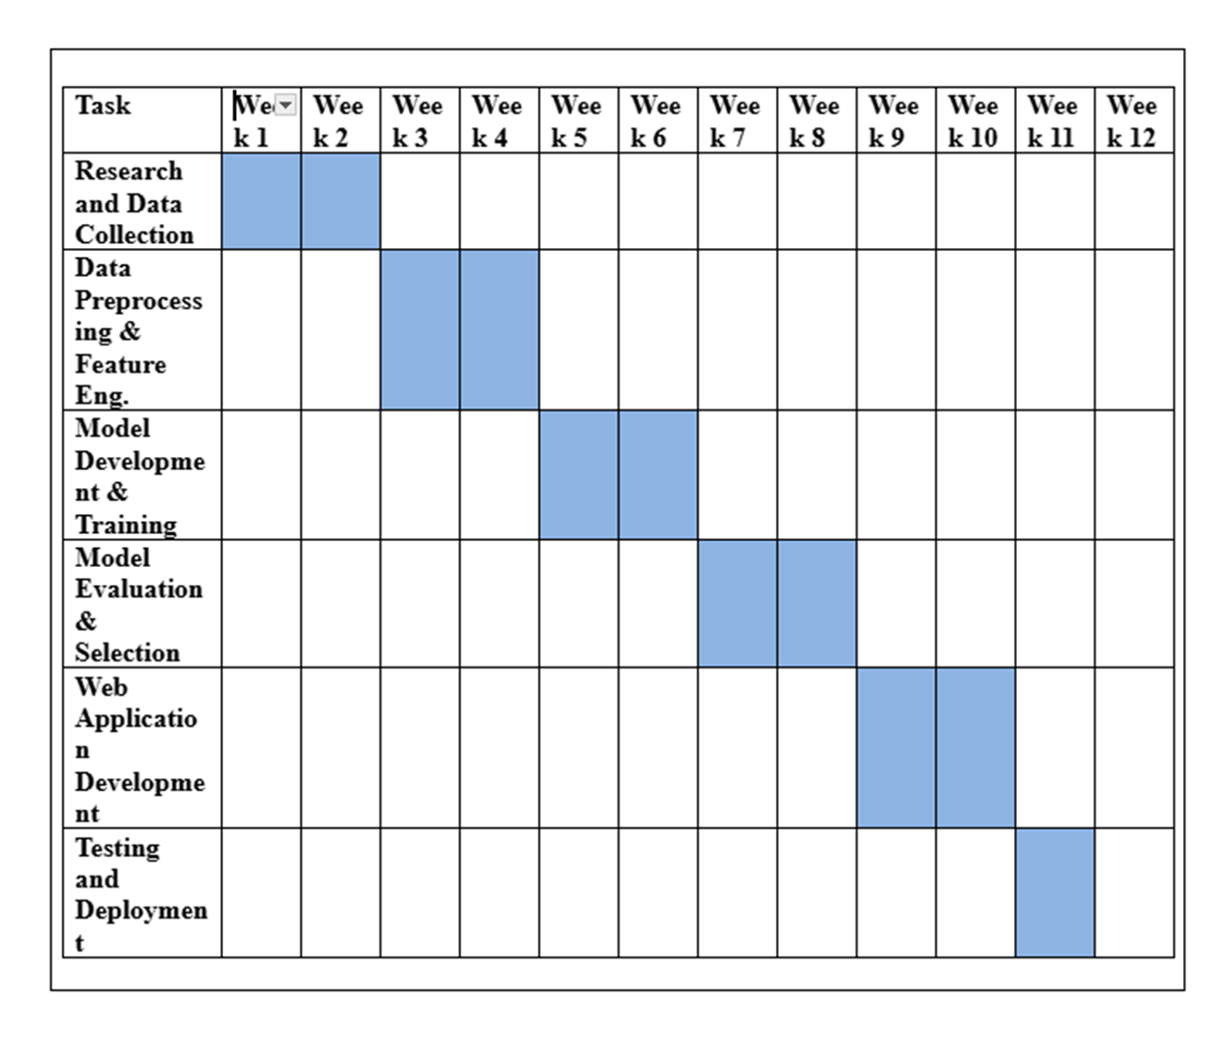
Gantt Chart
Department of CSE

Slide 21
Conclusion
This project offers a voice-based banking solution designed to overcome the challenges faced by rural populations, such as low literacy, limited digital skills, and language barriers. By utilizing OpenAI's Whisper model, the system allows users to interact with banking services using voice commands in their native language, like Kannada. It enables users to perform key tasks such as opening a bank account and filling out loan applications, which are often complicated and inaccessible for rural communities. The system transcribes and translates voice input into English, making it easier for users to access banking services. This solution fosters greater digital inclusion and empowers rural users to manage their finances independently.

Slide 22
A. Radford, J. W. Kim, T. Xu, G. Brockman, C. McLeavey, and I. Sutskever, “Robust Speech Recognition via Large-Scale Weak Supervision,” OpenAI, 2022.
A. Vaswani, N. Shazeer, N. Parmar, J. Uszkoreit, L. Jones, A. N. Gomez, Ł. Kaiser, and I. Polosukhin, “Attention is All You Need,” in Advances in Neural Information Processing Systems (NeurIPS), 2017.
A. Babu et al., “XLS-R: Self-Supervised Cross-Lingual Speech Representation Learning at Scale,” arXiv preprint arXiv:2111.09296, 2021.
A. Baevski, Y. Zhou, A. Mohamed, and M. Auli, “Unsupervised Speech Recognition,” arXiv preprint arXiv:2105.11084, 2021.
W. Chan, C. J. Wang, and N. Jaitly, “SpeechStew: Simply Mix All Available Speech Recognition Data to Train One Large Neural Network,” arXiv preprint arXiv:2104.02133, 2021.
D. S. Park et al., “SpecAugment: A Simple Data Augmentation Method for Automatic Speech Recognition,” in Proc. Interspeech, 2019.
References
Department of CSE

Slide 23
A. Narayanan et al., “Toward Domain-Invariant Speech Recognition via Large Scale Training,” in Proc. Interspeech, 2018.
S. Chen et al., “Maestro: Matched Speech Text Representations through Modality Matching,” arXiv preprint arXiv:2210.06674, 2022.
S. Chen et al., “UniSpeech-SAT: Universal Speech Representation Learning with Speaker-Aware Pre-Training,” arXiv preprint arXiv:2110.05752, 2022.
V. Panayotov, G. Chen, D. Povey, and S. Khudanpur, “Librispeech: An ASR corpus based on public domain audio books,” in Proc. ICASSP, 2015.
Department of CSE

Slide 24
Thank You
Department of CSE

